Slide 1
Predicting SpaceX Falcon 9
First-Stage Landing Success
Data Science Capstone Project Report — IBM Applied Data Science Capstone
Keming (Jolin) Jiao | October 2026
Project GitHub repository: https://github.com/keming-jiao/spacex-capstone

Slide 2
Outline
1
Executive Summary
2
Introduction
3
Methodology
4
Results
5
Conclusion
6
Innovative Insights
7
Appendix

Slide 3
Executive Summary
Methods
Key results
Data collection: SpaceX REST API (v4) + web scraping of the Wikipedia Falcon 9 launch table
Data wrangling: filtered to Falcon 9, imputed missing payload mass, built binary landing label Class
EDA with Python visualisation (Matplotlib/Seaborn) and SQL (SQLite)
Interactive visual analytics: Folium map and Plotly Dash dashboard
Predictive analysis: Logistic Regression, SVM, Decision Tree and KNN tuned with 10-fold GridSearchCV
90 Falcon 9 launches analysed; overall landing success rate 66.7%
Success rose from 0% (2010–2013) to 90% in 2019 — strong learning curve
KSC LC-39A has the most successful launches (10 of 13, 76.9%)
ES-L1, GEO, HEO and SSO orbits had 100% landing success; GTO was hardest (52%)
Best model: SVM — 83.3% test accuracy, 84.8% CV accuracy
Models never miss a real landing (0 false negatives); the remaining error is false positives

Slide 4
Introduction
Project background and context
Problems we want to answer
SpaceX advertises Falcon 9 launches at about $62 million, while other providers charge $165 million or more
Most of that saving comes from recovering and reusing the first stage
If we can predict whether the first stage will land, we can estimate the cost of a launch
A new competitor (Space Y) can use this to price its bids against SpaceX
Problem statement: predict whether the Falcon 9 first stage will land successfully (Class = 1) or not (Class = 0)
Which factors — payload mass, orbit, launch site, flight number, booster version — drive landing success?
How has the success rate changed over time?
Which classification model predicts landing outcome best, and how reliable is it?

Slide 5
Methodology
Data collection → wrangling → EDA → interactive analytics → predictive modelling

Slide 6
Methodology — Overview
Step | What was done
Data collection | SpaceX REST API + web scraping of Wikipedia (requests, BeautifulSoup)
Data wrangling | Filter Falcon 9, handle missing values, derive Class label from landing Outcome
EDA | Visualisation (scatter, bar, line charts) and SQL queries on SQLite
Interactive visual analytics | Folium maps (markers, clusters, distance lines) and Plotly Dash dashboard
Predictive analysis | Standardise, train/test split, GridSearchCV over LR, SVM, Tree, KNN; evaluate on test set
GitHub URL: https://github.com/keming-jiao/spacex-capstone

Slide 7
Data Collection
Two complementary sources were combined to describe every Falcon 9 launch
Source 1 — SpaceX REST API (api.spacexdata.com/v4/launches/past)
GET request → JSON → pandas DataFrame with json_normalize
Extra API calls by ID for rocket, launchpad, payload and core details
Source 2 — Web scraping (Wikipedia: List of Falcon 9 and Falcon Heavy launches)
requests + BeautifulSoup parse the launch HTML tables
Fields: flight no., date, booster, launch site, payload, mass, orbit, customer, launch & landing outcome
Output
API → 90 Falcon 9 launches (dataset_part_1.csv); Wikipedia → 121 launch records (spacex_web_scraped.csv)
GitHub URL: https://github.com/keming-jiao/spacex-capstone

Slide 8
Data Collection – SpaceX API
Flowchart of the API calls
GET /v4/launches/past
JSON response
→ json_normalize
Keep rocket, payloads, launchpad, cores, date
Helper API calls: getBoosterVersion, getLaunchSite, getPayloadData, getCoreData
Build DataFrame & filter Falcon 9 only
Impute PayloadMass with mean → CSV
Key code phrases
response = requests.get("https://api.spacexdata.com/v4/launches/past")
data = pd.json_normalize(response.json())
data = data[data['cores'].map(len)==1] # single-core launches
getBoosterVersion(data); getLaunchSite(data); getPayloadData(data); getCoreData(data)
data_falcon9 = launch_df[launch_df['BoosterVersion']!='Falcon 1']
data_falcon9['PayloadMass'].fillna(data_falcon9['PayloadMass'].mean(), inplace=True)
GitHub URL: https://github.com/keming-jiao/spacex-capstone/blob/main/01_data_collection_api.ipynb

Slide 9
Data Collection – Web Scraping
Flowchart of the scraping process
requests.get(Wikipedia static URL)
BeautifulSoup(html, 'html.parser')
find_all('table') → launch tables
Extract column names from <th>
Loop <tr>/<td>: parse date, booster, mass, orbit, outcomes
Dict → DataFrame → CSV (121 rows)
Key code phrases
static_url = 'https://en.wikipedia.org/w/index.php?title=List_of_Falcon_9_and_Falcon_Heavy_launches&oldid=1027686922'
soup = BeautifulSoup(requests.get(static_url).text, 'html.parser')
html_tables = soup.find_all('table'); first_launch_table = html_tables[2]
column_names = [extract_column_from_header(th) for th in first_launch_table.find_all('th')]
for table in soup.find_all('table', 'wikitable plainrowheaders collapsible'): ...
df = pd.DataFrame({k: pd.Series(v) for k, v in launch_dict.items()})
GitHub URL: https://github.com/keming-jiao/spacex-capstone/blob/main/02_data_collection_webscraping.ipynb

Slide 10
Data Wrangling
Cleaning, processing and creating the training label
Load dataset_part_1.csv
Check missing values & dtypes
Count launches per site & per orbit
Count landing outcomes
Map outcomes → Class (0/1)
Save dataset_part_2.csv
Missing values: PayloadMass imputed with mean during collection; LandingPad left missing for 26 launches where no pad was used
Landing outcomes such as 'True ASDS', 'True RTLS', 'True Ocean' = success (Class = 1)
bad_outcomes = {False ASDS, False Ocean, False RTLS, None ASDS, None None} → Class = 0
Resulting label: 90 launches, 66.7% success (df['Class'].mean())
One-hot encoding of Orbit, LaunchSite, LandingPad, Serial for modelling → dataset_part_3.csv (80 features)
GitHub URL: https://github.com/keming-jiao/spacex-capstone/blob/main/03_data_wrangling.ipynb

Slide 11
EDA with Data Visualization
Charts plotted and why
Chart | Variables | Purpose
Scatter (catplot) | Flight Number vs. Launch Site | Does experience at a site improve landing?
Scatter | Payload Mass vs. Launch Site | Are heavy payloads launched from specific sites, and do they land?
Bar chart | Success rate by Orbit | Which orbit types are easiest / hardest to recover from?
Scatter | Flight Number vs. Orbit | Is orbit success driven by experience?
Scatter | Payload Mass vs. Orbit | How payload interacts with orbit type
Line chart | Yearly average success rate | Trend of landing success over time
GitHub URL: https://github.com/keming-jiao/spacex-capstone/blob/main/05_eda_dataviz.ipynb

Slide 12
EDA with SQL — Summary of SQL Queries Performed
10 SQL queries run on the SPACEXTABLE table in SQLite (sqlite3 + pandas.read_sql)
# | SQL query performed (summary) | Purpose / what it answers
1 | SELECT DISTINCT Launch_Site | Names of the unique launch sites
2 | WHERE Launch_Site LIKE 'CCA%' LIMIT 5 | 5 records of launch sites beginning with 'CCA'
3 | SUM(PAYLOAD_MASS__KG_) WHERE Customer='NASA (CRS)' | Total payload mass carried for NASA (CRS)
4 | AVG(PAYLOAD_MASS__KG_) WHERE Booster_Version LIKE 'F9 v1.1%' | Average payload mass of booster F9 v1.1
5 | MIN(Date) WHERE Landing_Outcome='Success (ground pad)' | Date of first successful ground-pad landing
6 | WHERE drone-ship success AND 4000 < payload < 6000 | Boosters with drone-ship success in that payload range
7 | COUNT(*) GROUP BY Mission_Outcome | Total successful and failed mission outcomes
8 | subquery WHERE payload = (SELECT MAX(payload)) | Boosters that carried the maximum payload
9 | substr(Date,6,2) month, WHERE year 2015 AND drone-ship failure | 2015 failed drone-ship landings by month
10 | COUNT(*) GROUP BY Landing_Outcome ORDER BY DESC (2010-06-04 to 2017-03-20) | Rank landing outcomes in that period
GitHub URL: https://github.com/keming-jiao/spacex-capstone/blob/main/04_eda_sql.ipynb

Slide 13
Interactive Visual Analytics – Folium Map & Plotly Dash
Folium map
Plotly Dash dashboard
folium.Circle + Marker for every launch site (lat/long)
MarkerCluster with green (Class = 1) / red (Class = 0) markers per launch
MousePosition to read coordinates; PolyLine + distance label to the nearest coastline, railway, highway and city
Why: see whether location and surroundings relate to success
Dropdown: all sites or one launch site
Pie chart: successful launches by site (all) or success vs. failure (one site)
RangeSlider: payload range 0–10,000 kg
Scatter: payload vs. outcome, coloured by booster version category
Why: interactively compare sites, payload ranges and boosters
GitHub URL: https://github.com/keming-jiao/spacex-capstone/blob/main/06_launch_site_folium.ipynb
GitHub URL: https://github.com/keming-jiao/spacex-capstone/blob/main/07_spacex_dash_app.py

Slide 14
Predictive Analysis (Classification)
How the models were built, evaluated, improved and selected
Load X (dataset_part_3) and Y = Class
StandardScaler on features
train_test_split
80/20, random_state=2 (test n=18)
GridSearchCV (cv=10) for LR, SVM, Tree, KNN
Score on test set + confusion matrix
Select best model
Hyper-parameters tuned: LR (C), SVM (kernel, C, gamma), Decision Tree (criterion, splitter, max_depth, min_samples), KNN (n_neighbors, algorithm, p)
Model improvement: grid search picks parameters by 10-fold cross-validation accuracy on the training set
Evaluation: test-set accuracy, confusion matrix, comparison with a majority-class baseline
Selection rule: highest test accuracy; ties broken by cross-validation accuracy
GitHub URL: https://github.com/keming-jiao/spacex-capstone/blob/main/08_machine_learning_prediction.ipynb

Slide 15
Results
EDA results
Interactive analytics
Predictive analysis
Success rate grows with flight number and year; 66.7% overall. Orbit type and payload matter.
All sites sit near the coast; KSC LC-39A has the most successes; heavier payloads tie to newer boosters.
SVM best: 83.3% test accuracy; no false negatives.

Slide 16
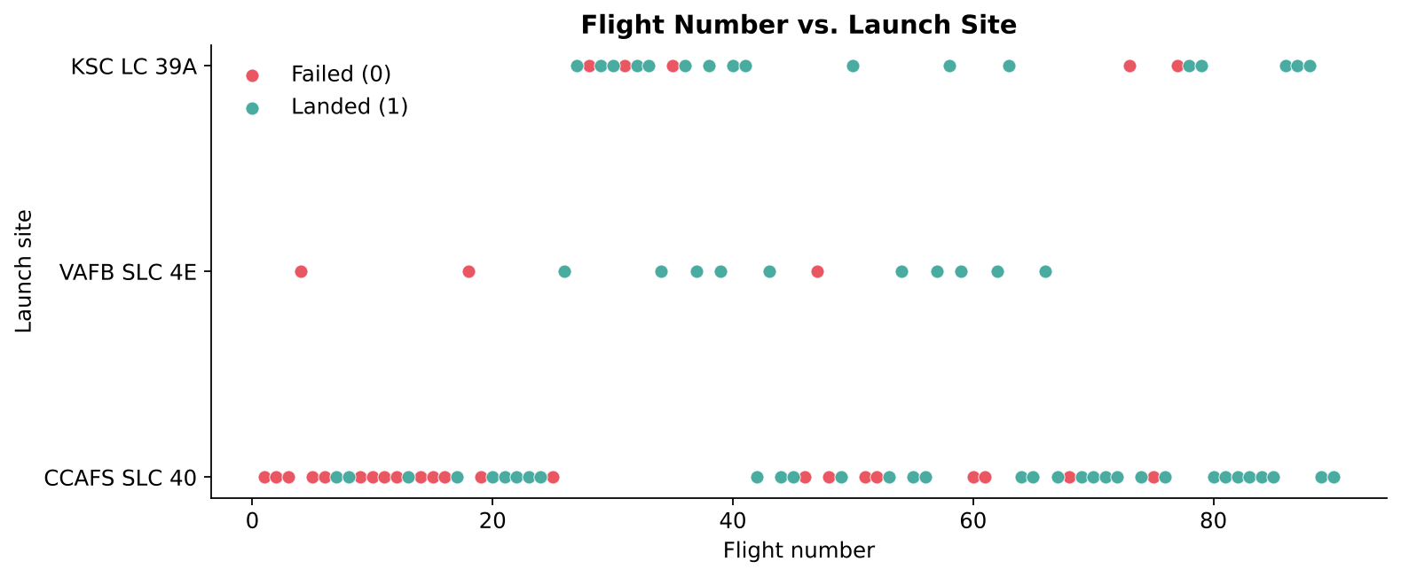
Scatter Plot — Flight Number vs. Launch Site
Key takeaways
Early flights (< 25) were mostly from CCAFS SLC 40 and mostly failed
Later flights succeed far more often at every site — experience matters
KSC LC 39A only starts after flight ~25, so it benefits from later, more mature boosters

Slide 17
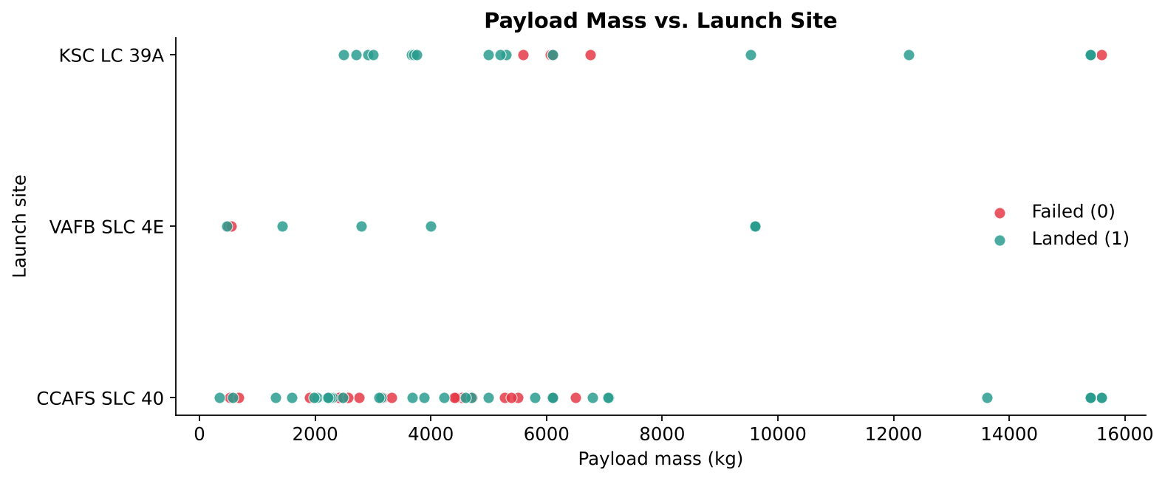
Scatter Plot — Payload Mass vs. Launch Site
Key takeaways
VAFB SLC 4E launches no payload heavier than ~10,000 kg
Heavy payloads (> 8,000 kg) mostly landed successfully
Light payloads at CCAFS SLC 40 show many early failures

Slide 18
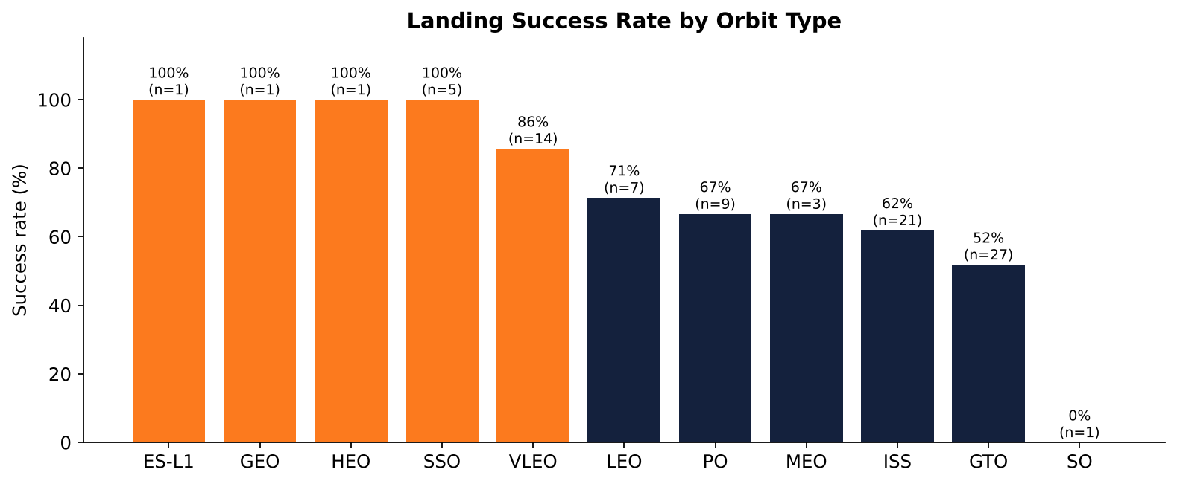
Bar Chart — Success Rate vs. Orbit Type
Key takeaways
ES-L1, GEO, HEO and SSO: 100% success (but GEO/HEO/ES-L1 have only 1 launch each)
VLEO 86% (n=14) is the most reliable orbit with a meaningful sample
GTO is the hardest: 52% of 27 launches; SO 0% (n=1)

Slide 19
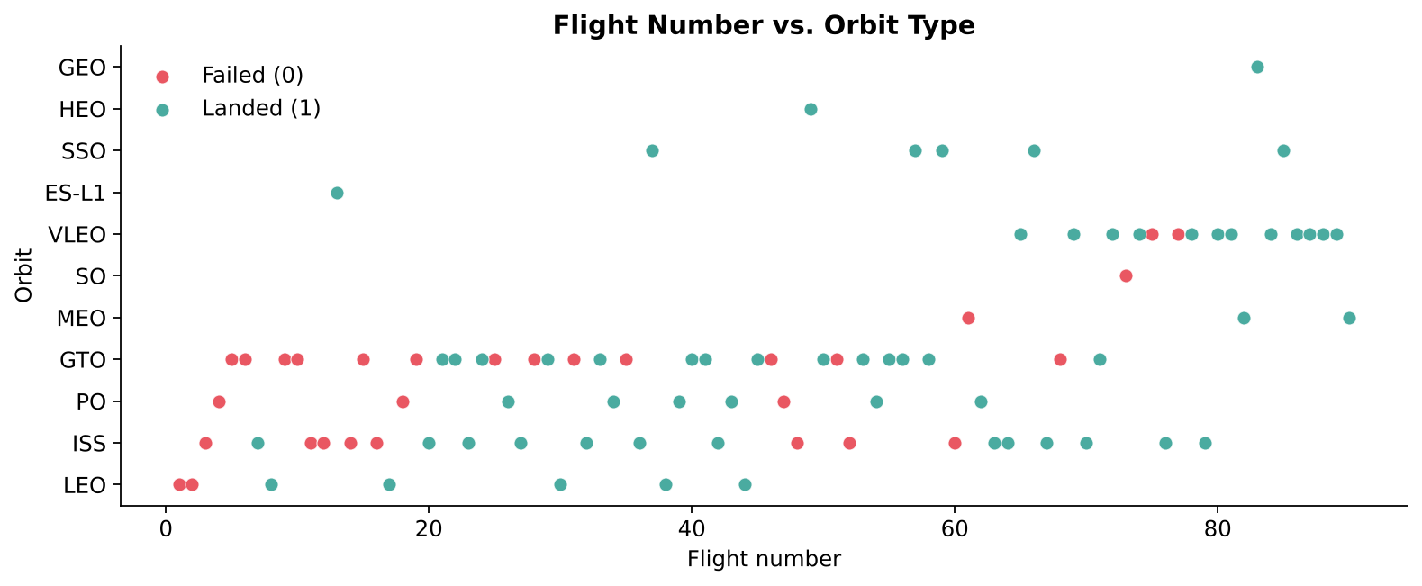
Scatter Plot — Flight Number vs. Orbit Type
Key takeaways
In LEO, success appears linked to the number of flights
In GTO there is no clear relationship with flight number
VLEO launches only began at high flight numbers and mostly succeed

Slide 20
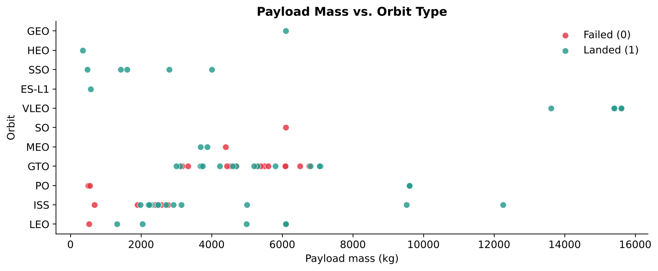
Scatter Plot — Payload Mass vs. Orbit Type
Key takeaways
With heavy payloads, successful landings are more common for PO, LEO and ISS
GTO mixes successes and failures across all payload masses
Payload alone does not separate the classes — orbit must be considered too

Slide 21
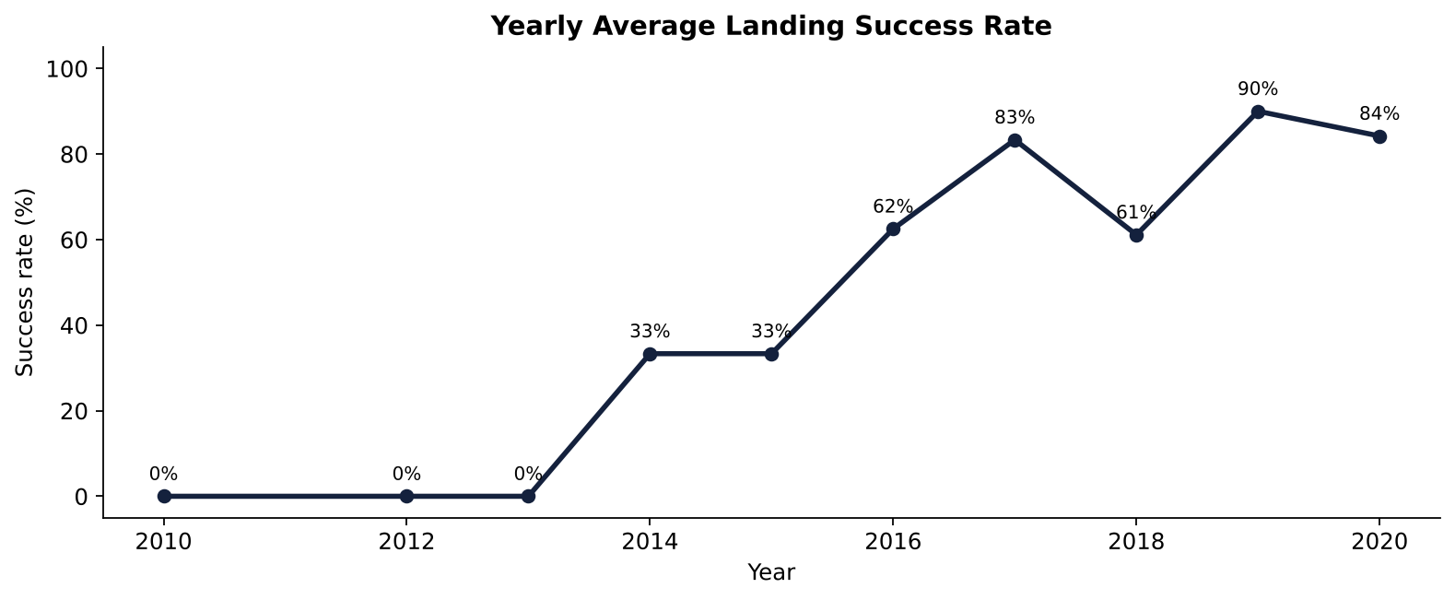
Line Chart — Launch Success Yearly Trend
Key takeaways
0% success from 2010 to 2013
Success rate kept increasing from 2013 to 2020 (90% in 2019)
Small dip in 2018 when new Block 4/5 hardware was introduced

Slide 22
EDA with SQL Result — All Launch Site Names
SELECT DISTINCT Launch_Site FROM SPACEXTABLE
Launch_Site
CCAFS LC-40
VAFB SLC-4E
KSC LC-39A
CCAFS SLC-40
Result: SpaceX used 4 unique launch sites (CCAFS LC-40 and SLC-40 are the same pad renamed).

Slide 23
EDA with SQL Result — Launch Site Names Beginning with 'CCA'
SELECT Date, Booster_Version, Launch_Site, Payload, Customer, Landing_Outcome FROM SPACEXTABLE WHERE Launch_Site LIKE 'CCA%' LIMIT 5
Date | Booster_Version | Launch_Site | Payload | Customer | Landing_Outcome
2010-06-04 | F9 v1.0 B0003 | CCAFS LC-40 | Dragon Spacecraft Qualification Unit | SpaceX | Failure (parachute)
2010-12-08 | F9 v1.0 B0004 | CCAFS LC-40 | Dragon demo flight C1, two CubeSats, barrel of Brouere cheese | NASA (COTS) NRO | Failure (parachute)
2012-05-22 | F9 v1.0 B0005 | CCAFS LC-40 | Dragon demo flight C2 | NASA (COTS) | No attempt
2012-10-08 | F9 v1.0 B0006 | CCAFS LC-40 | SpaceX CRS-1 | NASA (CRS) | No attempt
2013-03-01 | F9 v1.0 B0007 | CCAFS LC-40 | SpaceX CRS-2 | NASA (CRS) | No attempt
Result: The first 5 launches were all from CCAFS LC-40; early landings failed or were not attempted.

Slide 24
EDA with SQL Result — Total Payload Mass (NASA CRS)
SELECT SUM(PAYLOAD_MASS__KG_) AS total_payload FROM SPACEXTABLE WHERE Customer='NASA (CRS)'
total_payload
45596
Result: Boosters launched for NASA (CRS) carried 45,596 kg in total.

Slide 25
EDA with SQL Result — Average Payload Mass by F9 v1.1
SELECT ROUND(AVG(PAYLOAD_MASS__KG_),2) AS avg_payload FROM SPACEXTABLE WHERE Booster_Version LIKE 'F9 v1.1%'
avg_payload
2534.67
Result: The F9 v1.1 booster family carried on average 2534.67 kg per launch.

Slide 26
EDA with SQL Result — First Successful Ground Landing Date
SELECT MIN(Date) AS first_success FROM SPACEXTABLE WHERE Landing_Outcome='Success (ground pad)'
first_success
2015-12-22
Result: The first successful ground-pad landing happened on 2015-12-22.

Slide 27
EDA with SQL Result — Successful Drone Ship Landing with Payload between 4000 and 6000
SELECT Booster_Version FROM SPACEXTABLE WHERE Landing_Outcome='Success (drone ship)' AND PAYLOAD_MASS__KG_>4000 AND PAYLOAD_MASS__KG_<6000
Booster_Version
F9 FT B1022
F9 FT B1026
F9 FT B1021.2
F9 FT B1031.2
Result: Four F9 FT boosters landed on a drone ship while carrying 4,000–6,000 kg.

Slide 28
EDA with SQL Result — Total Number of Successful and Failure Mission Outcomes
SELECT Mission_Outcome, COUNT(*) AS n FROM SPACEXTABLE GROUP BY Mission_Outcome
Mission_Outcome | n
Failure (in flight) | 1
Success | 98
Success | 1
Success (payload status unclear) | 1
Result: 100 of 101 missions succeeded (incl. 1 with unclear payload status); only 1 in-flight failure.

Slide 29
EDA with SQL Result — Boosters Carried Maximum Payload
SELECT DISTINCT Booster_Version FROM SPACEXTABLE WHERE PAYLOAD_MASS__KG_=(SELECT MAX(PAYLOAD_MASS__KG_) FROM SPACEXTABLE)
Booster_Version
F9 B5 B1048.4
F9 B5 B1049.4
F9 B5 B1051.3
F9 B5 B1056.4
F9 B5 B1048.5
F9 B5 B1051.4
F9 B5 B1049.5
F9 B5 B1060.2
F9 B5 B1058.3
F9 B5 B1051.6
F9 B5 B1060.3
F9 B5 B1049.7
Result: Only Block 5 (F9 B5) boosters carried the maximum payload (15,600 kg).

Slide 30
EDA with SQL Result — 2015 Launch Records
SELECT substr(Date,6,2) AS month, Landing_Outcome, Booster_Version, Launch_Site FROM SPACEXTABLE WHERE substr(Date,1,4)='2015' AND Landing_Outcome='Failure (drone ship)'
month | Landing_Outcome | Booster_Version | Launch_Site
01 | Failure (drone ship) | F9 v1.1 B1012 | CCAFS LC-40
04 | Failure (drone ship) | F9 v1.1 B1015 | CCAFS LC-40
Result: Two drone-ship landing failures in 2015 (January and April), both F9 v1.1 from CCAFS LC-40.

Slide 31
EDA with SQL Result — Rank Landing Outcomes Between 2010-06-04 and 2017-03-20
SELECT Landing_Outcome, COUNT(*) AS n FROM SPACEXTABLE WHERE Date BETWEEN '2010-06-04' AND '2017-03-20' GROUP BY Landing_Outcome ORDER BY n DESC
Landing_Outcome | n
No attempt | 10
Success (drone ship) | 5
Failure (drone ship) | 5
Success (ground pad) | 3
Controlled (ocean) | 3
Uncontrolled (ocean) | 2
Failure (parachute) | 2
Precluded (drone ship) | 1
Result: 'No attempt' was most common; drone-ship successes and failures were tied at 5 each.

Slide 32
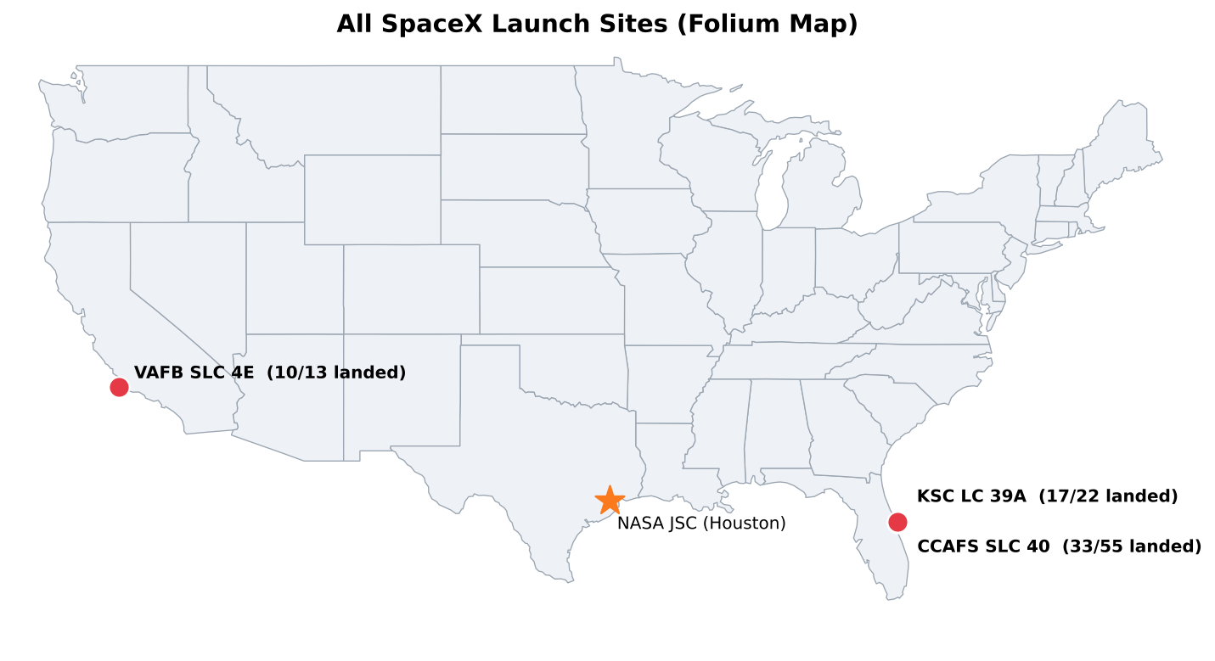
Folium Map — All Launch Site Markers on a Global Map
Key takeaways
All launch sites are in the USA: Florida (east coast) and California (west coast)
Every site is very close to the ocean — failed boosters fall into water, not on people
Sites are as far south as possible to gain speed from Earth's rotation

Slide 33
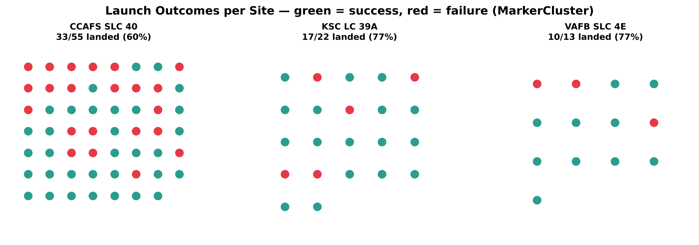
Folium Map — Color-labeled Launch Records (Success/Failure) per Site
Key takeaways
Green marker = successful landing, red = failure (MarkerCluster)
KSC LC 39A and VAFB SLC 4E: about 77% success
CCAFS SLC 40: most launches (55) but lowest rate (60%) because early test flights were there

Slide 34
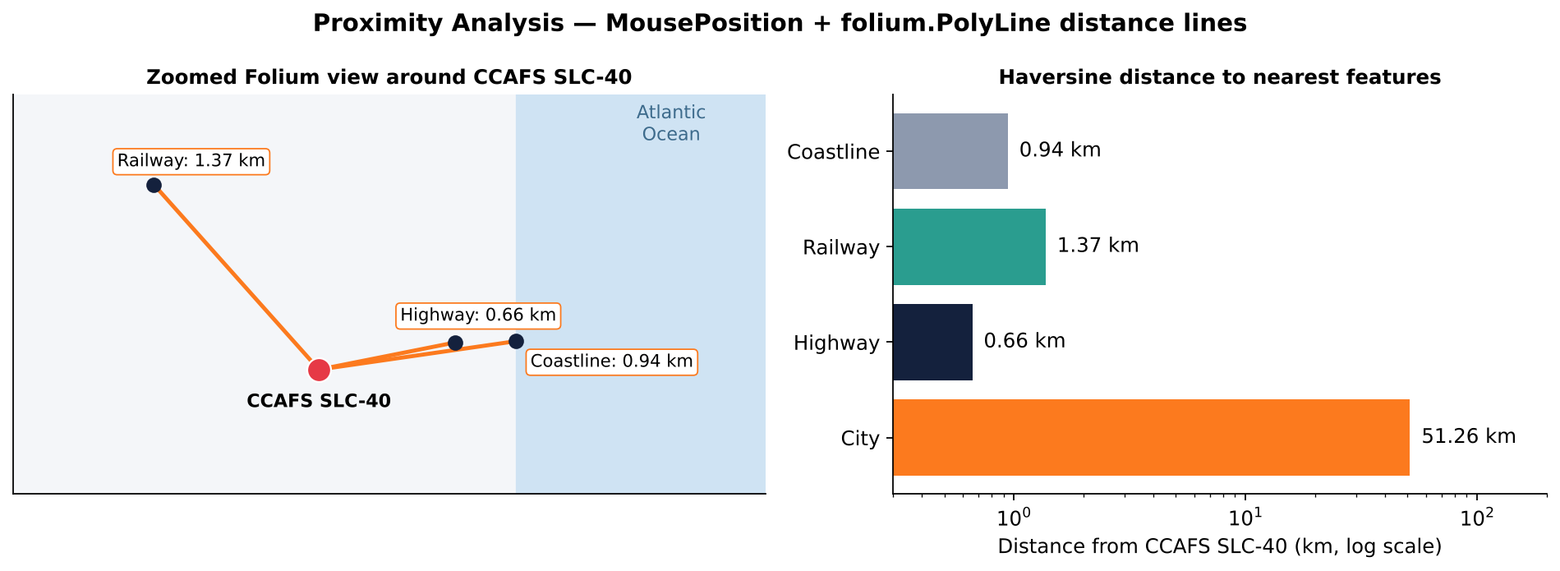
Folium Map — Launch Site Proximity Analysis (Coastline, Railway, Highway, City)
Key takeaways
Coastline 0.94 km, highway 0.66 km, railway 1.37 km — logistics are close
Nearest city (Melbourne) is 51.26 km away — safety buffer from people
Launch sites balance easy transport against public safety

Slide 35
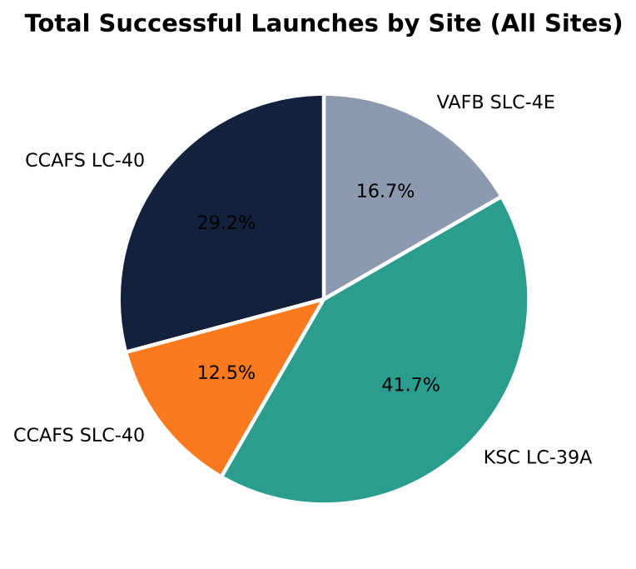
Plotly Dash — Success Pie Chart: Launch Success Count for All Sites
Key takeaways
Dashboard screenshot: success pie chart (px.pie) of total successful launches by launch site, dropdown = All Sites
KSC LC-39A contributes the largest share of successful launches (10 of 24)
CCAFS LC-40 is second; CCAFS SLC-40 and VAFB SLC-4E contribute least

Slide 36
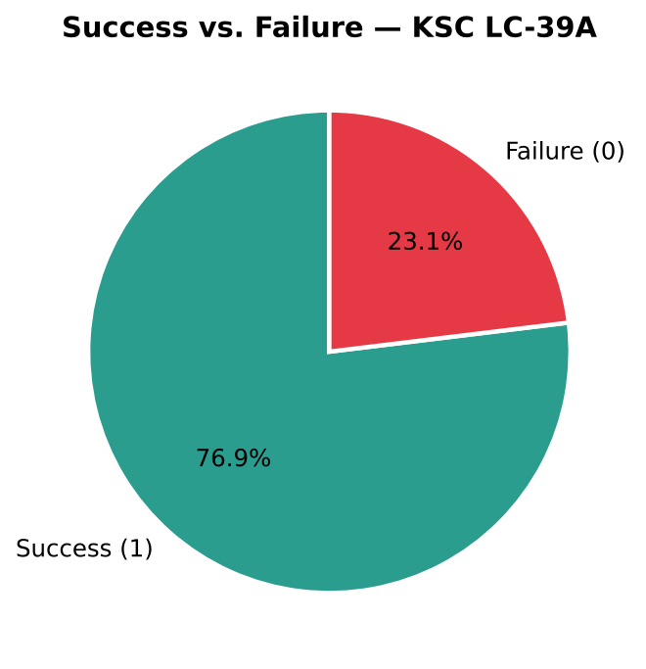
Plotly Dash — Success Pie Chart: Site with the Highest Launch Success Ratio
Key takeaways
Dashboard screenshot: success pie chart of success (class 1) vs. failure (class 0) for the selected site KSC LC-39A
KSC LC-39A: 10 successes, 3 failures → 76.9% success
Highest success ratio of all sites

Slide 37
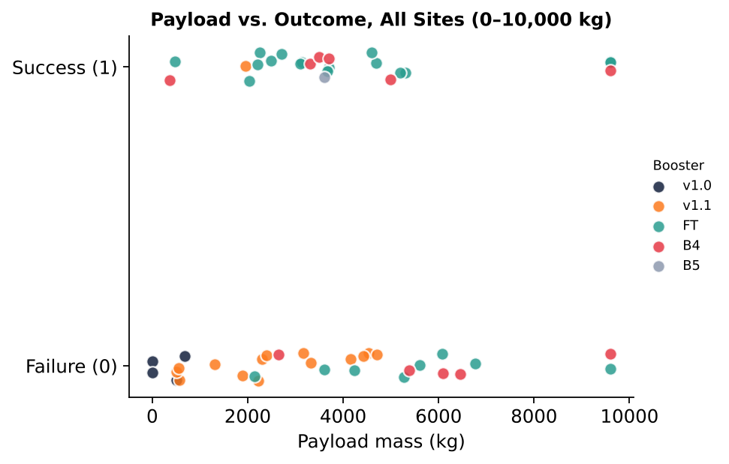
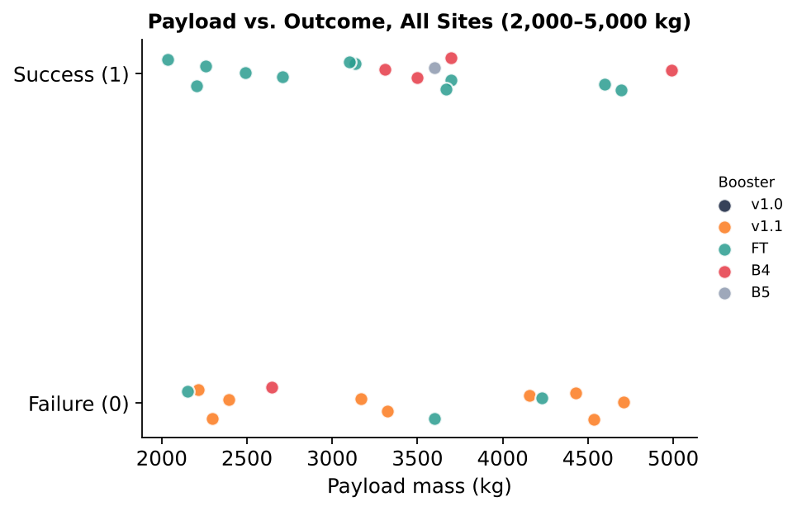
Plotly Dash — Payload vs. Launch Outcome Scatter Plot
Scatter plot of payload mass (x) vs. launch outcome class (y), coloured by booster version; left 0–10,000 kg, right 2,000–5,000 kg
Payload vs. launch outcome scatter plot: success rate for payloads ≤ 4,000 kg is 47.1% vs. 36.4% above 4,000 kg
FT boosters have the highest success rate among common versions (67%, n=24); v1.1 the lowest (7%, n=15)

Slide 38
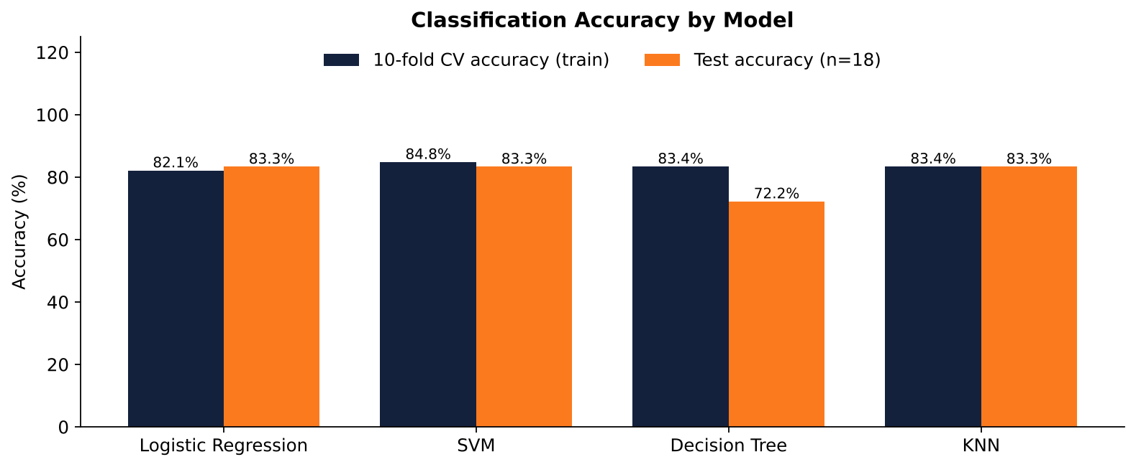
Predictive Analysis Results — Model Accuracy
Logistic Regression, SVM, Decision Tree and KNN evaluated on the test set
Model | CV acc. | Test acc.
Logistic Regression | 82.1% | 83.3%
SVM | 84.8% | 83.3%
Decision Tree | 83.4% | 72.2%
KNN | 83.4% | 83.3%
LR, SVM and KNN tie on the test set (83.3%, 15/18 correct); Decision Tree drops to 72.2%
SVM has the highest CV accuracy (84.8%) → best model
Majority-class baseline is 66.7% — the models add ~17 points

Slide 39
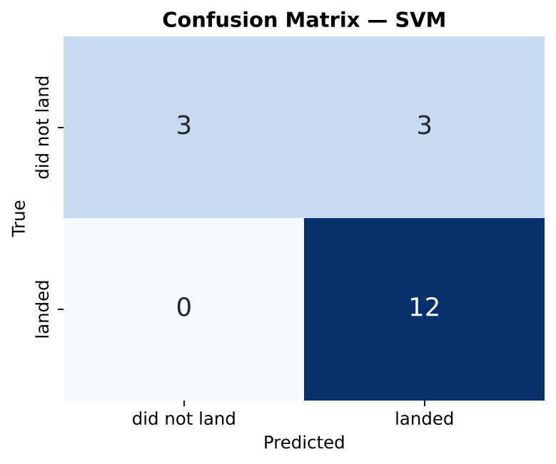
Predictive Analysis Results — Confusion Matrix of the Best Model (SVM)
True positives 12: every real landing in the test set was predicted correctly (recall = 100%)
True negatives 3; false negatives 0
False positives 3: the model sometimes predicts a landing that did not happen (precision = 80.0%)
Business meaning: the model is optimistic — a bidder using it might under-estimate SpaceX's cost on risky missions
Best parameters: kernel='sigmoid', C=1, gamma=0.0316

Slide 40
Conclusion
Landing success depends strongly on experience: from 0% before 2014 to 90% in 2019, and 100% for the last 10 flights
Orbit matters: ES-L1, GEO, HEO, SSO and VLEO launches land most reliably; GTO is hardest
KSC LC-39A has the most successful launches and the highest success ratio of any site
Launch sites are close to coastline, highways and railways, but far from cities
SVM is the best classifier (83.3% test, 84.8% CV accuracy); all models catch every real landing but over-predict success
For Space Y: a launch to GTO with an older booster is the highest-risk scenario and should be priced with less reuse savings

Slide 41
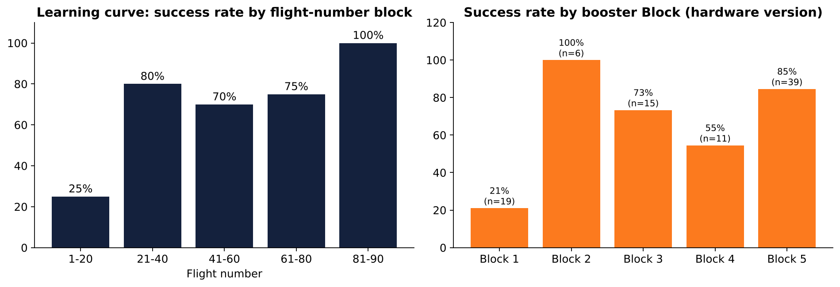
Innovative Insights — Beyond the Template
What actually drives a landing? Experience and hardware, not just payload
Learning curve: flights 1–20 landed only 25%; flights 81–90 landed 100%
Block 1 boosters: 21%; Block 5: 85% (n=39)
Reused boosters landed more often (78% vs. 58%) — reuse did not add risk
GridFins is the single most important feature in the tree model (54% importance): it marks a real landing attempt
Idea for Space Y: price bids with a cost model = base cost − P(landing) × booster value, using P(landing) from the classifier.

Slide 42
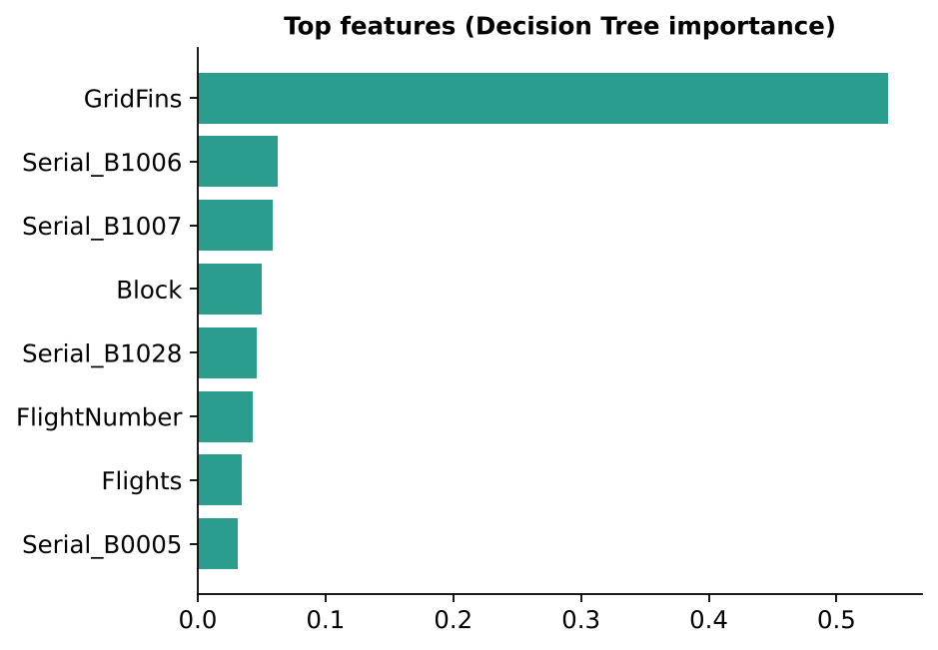
Appendix — Hyper-parameters and Feature Importance
Model | Best parameters (GridSearchCV, cv=10)
Logistic Regression | C=1, penalty=l2, solver=lbfgs
SVM | C=1, gamma=0.0316, kernel=sigmoid
Decision Tree | criterion=gini, max_depth=10, max_features=sqrt, min_samples_leaf=1, min_samples_split=2, splitter=random
KNN | algorithm=auto, n_neighbors=6, p=1
Data files: dataset_part_1.csv (API), spacex_web_scraped.csv (scraping), dataset_part_2.csv (labelled), dataset_part_3.csv (features), Spacex.csv (SQL), spacex_launch_dash.csv (dashboard)
GitHub URL: https://github.com/keming-jiao/spacex-capstone

Slide 43
Thank you!
https://github.com/keming-jiao/spacex-capstone

